Slide 1


COMMUNITY COMPANION CHALLENGE 2024
COMMUNITY COMPANION CHALLENGE
2024
The Hidden Factors: Exploring the Impact of Social Determinants on Health
TEAM CODE:
DA24

Slide 2




COMMUNITY COMPANION CHALLENGE 2024
Understanding The Problem Statement
SDOH DATA
Lack of a Comprehensive Picture due to binary evaluation
Health Disparities
HOW TO COMPENSATE
Surveys and Self Reporting and time consuming and are not reliable
Social Factor Affecting
Healthcare Costs
GOAL
IMPORTANCE
1
RISK PROFILE
FINE GRAINED ANALYSIS
QUICK ACTIONS
PREVENTIVE MEASURE
Generate risk profile based on patient data input
We considered interdependencies between social determinant variables
These actions are catered to every individual to provide effective support.
Solve problems before they become urgent and/or lead to other problems.
2
ACTIONABLE INSIGHTS

Slide 3
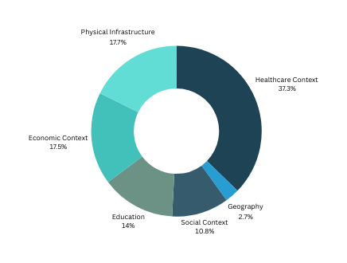
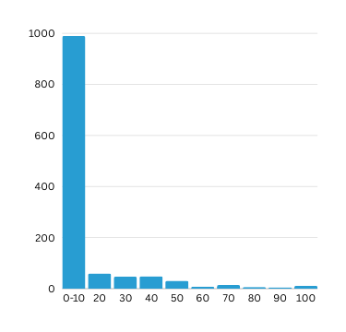
COMMUNITY COMPANION CHALLENGE 2024
Dataset Insights
1405
3K
41K
85K
Problems
Features
Counties
Zip Codes
Tracts
Surplus of variables
Numerous missing values
Risk Identification and Assignment difficulty
Large number of Zip codes
Non uniform variables across counties, Zip codes and tracts
Distribution of available data for the different domains of SDOH.
Distribution of variables by their null value percentages.

Slide 4

COMMUNITY COMPANION CHALLENGE 2024
Dataset Preparation
1. Outliers Removal
2. Missing Values
3. Unnormalised Values
Some SDOH variables exhibit outliers diverging from typical values
Several variables exhibited a significant amount of missing data
SDOH variables displayed wide data range disparities.
Outliers were detected and eliminated via boxplot analysis
Variables with missing data exceeding 50% were excluded
Normalization was achieved through min-max scaling
4. Feature Name
Discrepancy
5. Absence of Primary
Column
6. Missing values
in 2020 data
Identical features across datasets had varying names
Datasets varied in primary columns, including tract, zip code, and county
SDOH variables exhibited numerous missing values for the 2020 dataset
Features from diverse datasets were unified under consistent names
Employed a zip code-census tract crosswalk dataset to link census tract and zip code
Missing values were filled using
the most recent available data from the 2018 or 2019 datasets

Slide 5
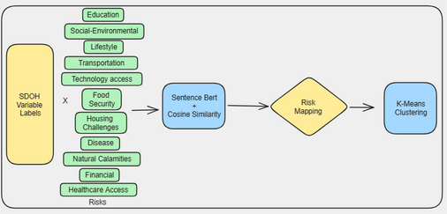

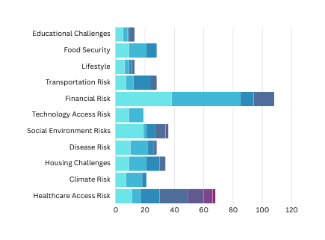
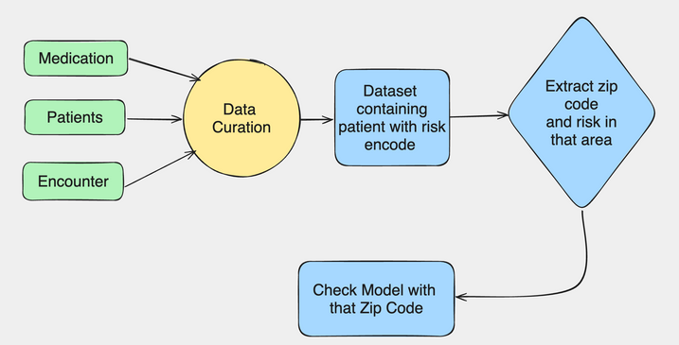

COMMUNITY COMPANION CHALLENGE 2024
Initial Steps
Risk Identificaton
Input Parameter Mapping
AHCM
Health Leads
PRAPARE
In the last 12 months, have you needed to see a doctor, but could not because of cost?
Financial Risk
In the last 12 months, has the electric, gas, oil, or water company threatened to shut off your services in your home?
How hard is it for you to pay for the very basics like food, housing, medical care, and heating?
11 RISKS IDENTIFIED
Grouping Similar Clusters
Feature to Risk Mapping
Sentence BERT
TF - IDF

Slide 6
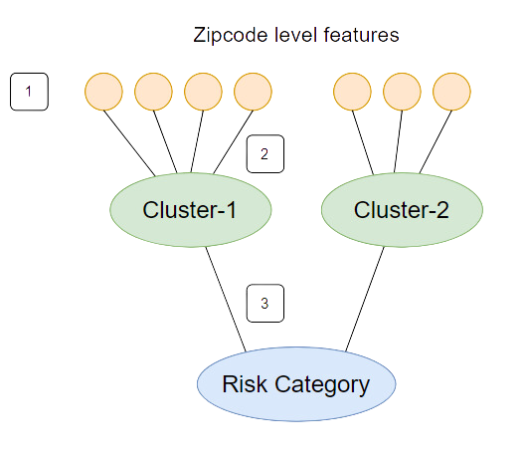
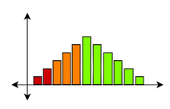
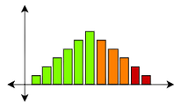
COMMUNITY COMPANION CHALLENGE 2024
Towards the Scorecard
Distribution based thresholding for risk identification [1]
Depending on the direction of the influence of the feature on the corresponding risk identified, we set up percentile based threshold in the ordering high-mid-low or low-mid-high
Weighted Aggregation of Individual Risks on Cluster [2] and Risk Level [3]
Additional Risk Categories
The Individual Risks were added using a weighted combination based on whether the feature belonged to tract, zip or county level and then normalized. This was done at both cluster and risk level
Disease Risk
2. Life Expectancy Risk

Slide 7
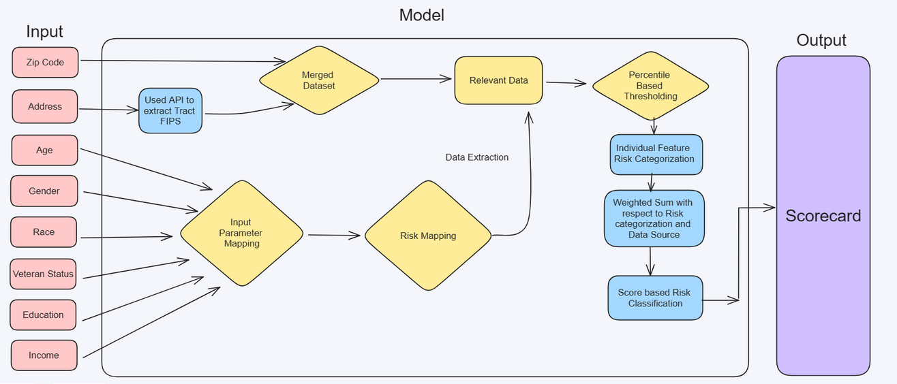
COMMUNITY COMPANION CHALLENGE 2024
Model Pipeline

Slide 8
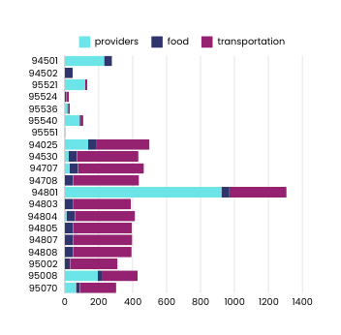
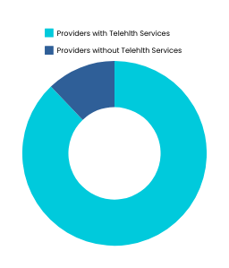
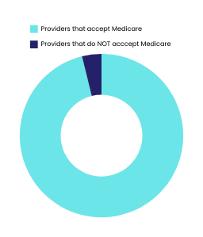
COMMUNITY COMPANION CHALLENGE 2024
Actionable Insights
Fine grained insights
We have suggested solutions based on specific sub-risks within each risk
Focusing on interactions
Example: For Transportation risk, we have suggested tele-health services only if the technology access risk is low.
General as well as specific actions
We have suggested nearest health service providers, hospitals, clinics based on needs for both patients and physicians

Slide 9
COMMUNITY COMPANION CHALLENGE 2024
Curating a testing dataset - Synthea
Patient
Condition
Medication
Contains patient’s information such as age, race, gender, demographics, location, etc.
Used to extract input parameters such as Zip code.
Contains patient’s health conditions as prescribed by the doctors.
Used to associate various health conditions with risk identified by our model.
Contains date and information of medication prescribed to the patient.
Used to filter out relevant recent data (2018, 2019, 2020)

Slide 10
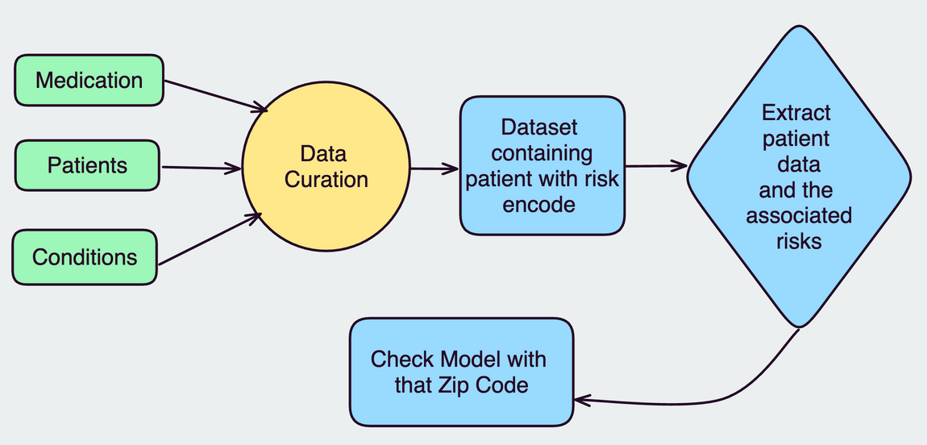
COMMUNITY COMPANION CHALLENGE 2024
Curating a testing dataset - Synthea

Slide 11



COMMUNITY COMPANION CHALLENGE 2024
Examples
Zip Code : 2151 | Age: 30 | M
Existing Risk : Lung Disease , Alcohol Usage
Risk Identified: Social Environmental Risk (Drug/Alcohol), Diseases RIsk (Lungs)
Actions : Provide Education and Awareness regarding Alcohol Abuse
Zip Code : 2136 | Age: Unknown | F
Existing Risk : Transportation Risk, Mental Health
Risk Identified: Transportation Risk, Lifestyle Risk
Actions : Provide Transport Vouchers and Homecare provider

Slide 12
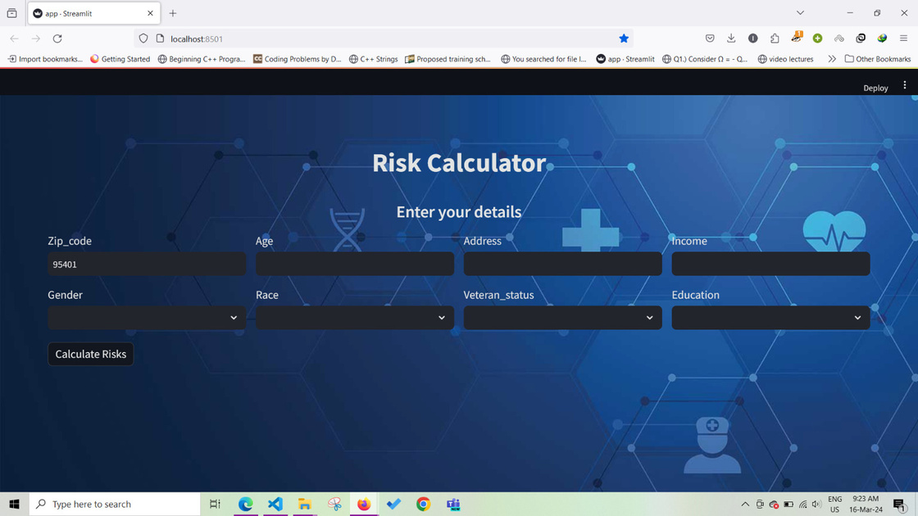
COMMUNITY COMPANION CHALLENGE 2024
UI and UX

Slide 13
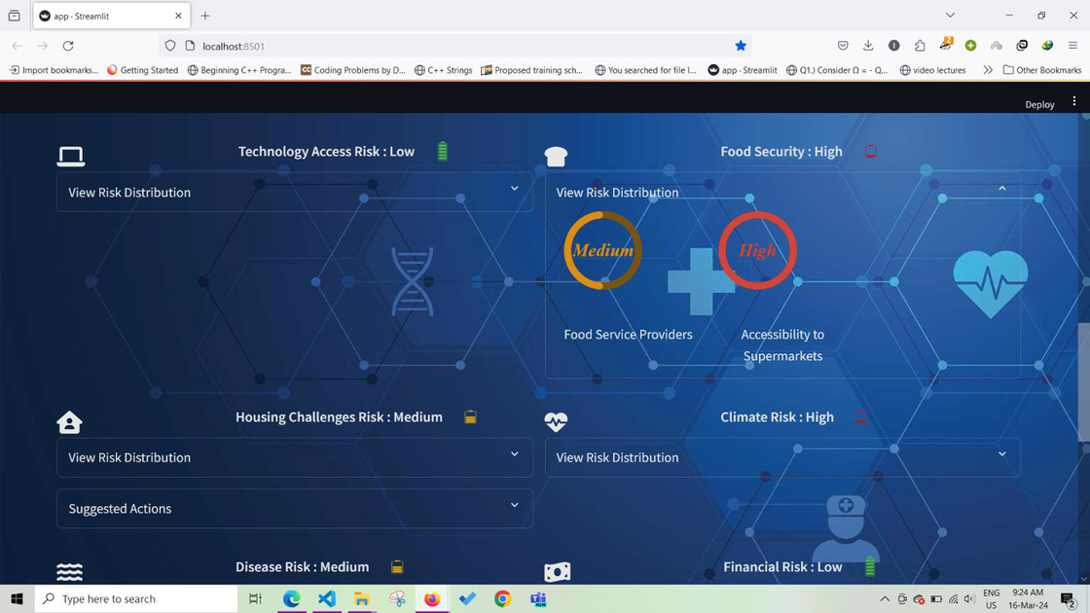
COMMUNITY COMPANION CHALLENGE 2024
UI and UX

Slide 14
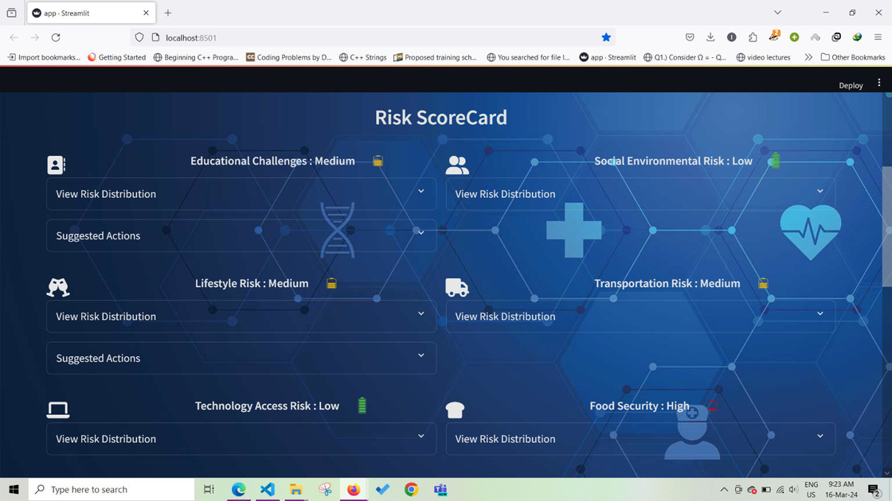
COMMUNITY COMPANION CHALLENGE 2024
UI and UX

Slide 15

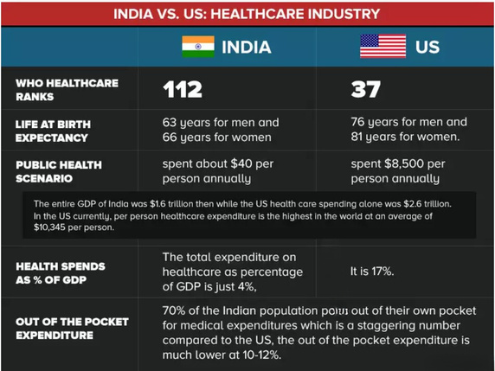
COMMUNITY COMPANION CHALLENGE 2024
The India Challenge
What is different
Disparities in access, the organization of healthcare services, and data quality
Lesser technological advancements and infrasturcture developements
Need for advance healthcare delivery in India
What do we deliver
The predictive model employs automated clustering, risk detection, and thresholding processes
Adaptable to diverse datasets, including the socioeconomic and healthcare variables critical for India
Can address the unique challenges of the Indian healthcare
Future works
Adjust the model's thresholds to align with India's specific healthcare needs
Incorporate features into the model that reflect India's unique healthcare challenges

Slide 16

COMMUNITY COMPANION CHALLENGE 2024
Conclusion
The model utilizes a comprehensive set of features to predict various risks, demonstrating its ability to handle complex datasets
It efficiently identifies and categorizes each risk and associated sub-risks into high, medium, or low levels, offering targeted preventive actions to mitigate these risks
By facilitating early intervention and promoting preventive care, the model empowers communities to proactively safeguard their health against various diseases, contributing not only to disease prevention but also encouraging healthier lifestyles overall

Slide 17

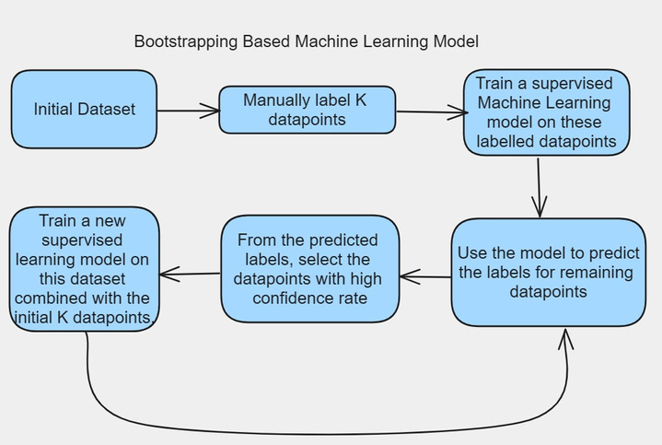
COMMUNITY COMPANION CHALLENGE 2024
Future Work
Explore model training enhancements through bootstrap methods, employing either machine learning or deep learning techniques for improved robustness and accuracy.
Implement language model (LLM) fine-tuning and evaluate perplexity scores to assess output confidence and refine predictive performance.

Slide 18
THANK YOU
We invite any questions

